Slide 1
Container Host Cluster Docker Swarm
By
Arun
CDAC,Pune

Slide 2
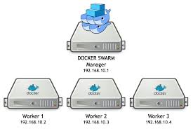

Slide 3
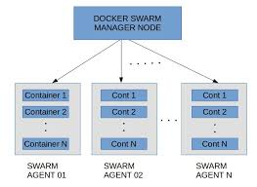

Slide 4
Master node = 192.168.201.134
Worker I = 192.168.201.136
Worker II = 192.168.201.135

Slide 5
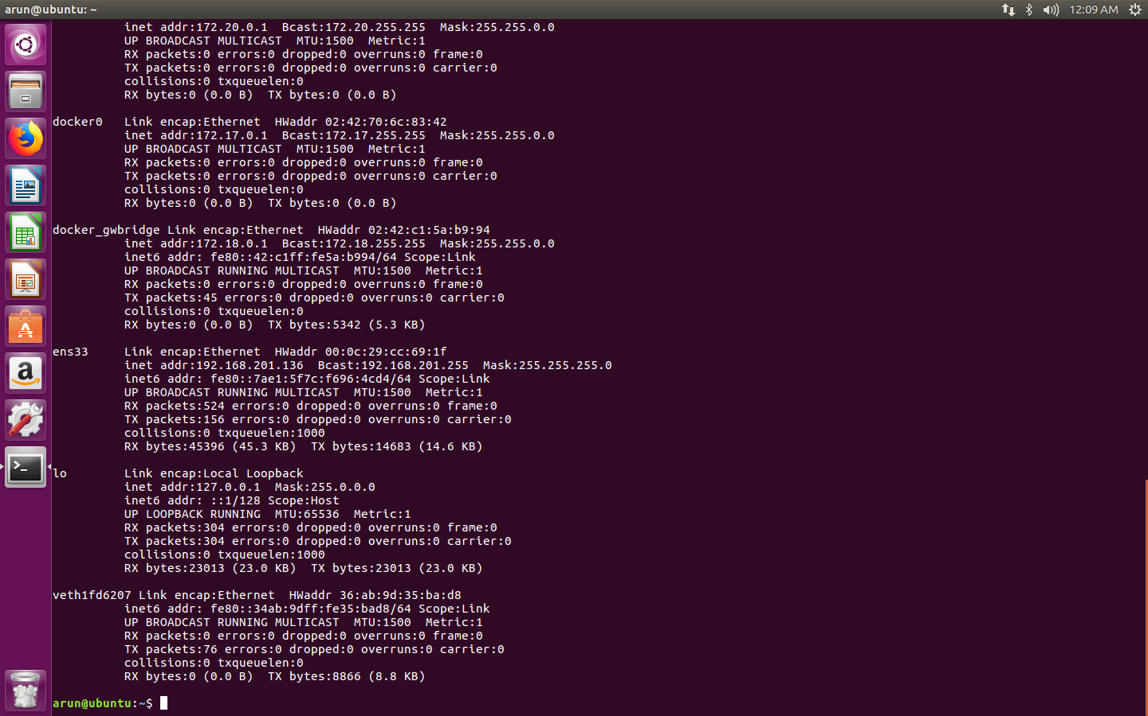

Slide 6


Slide 7
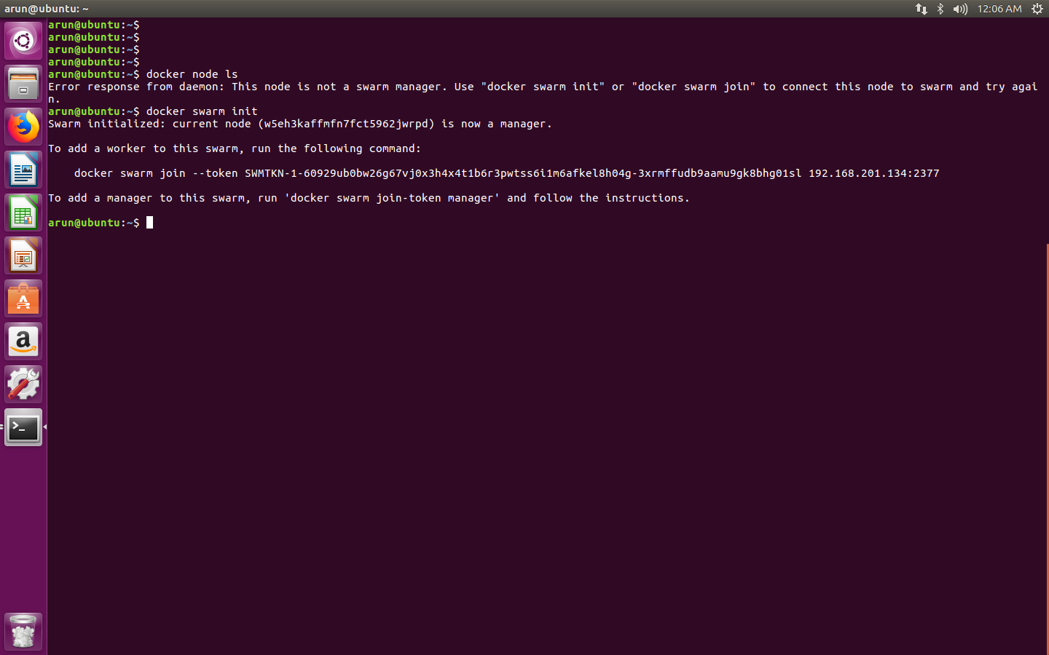

Slide 8
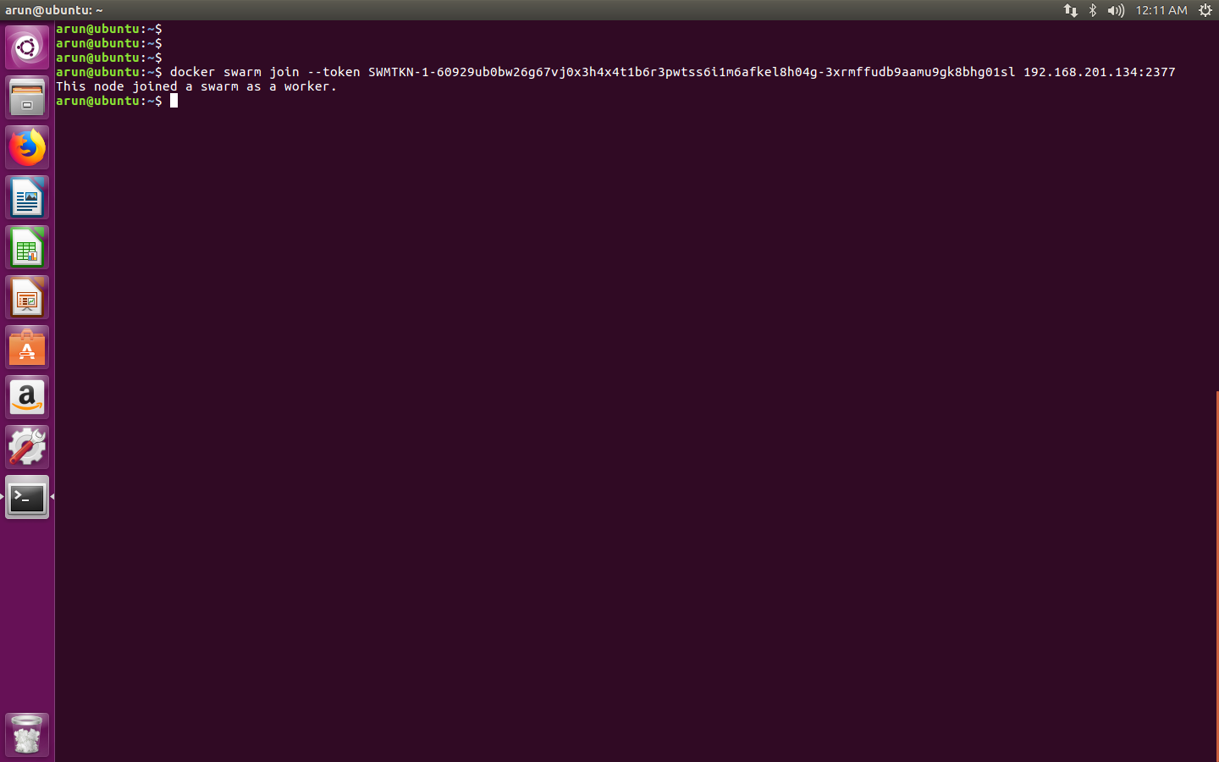

Slide 9
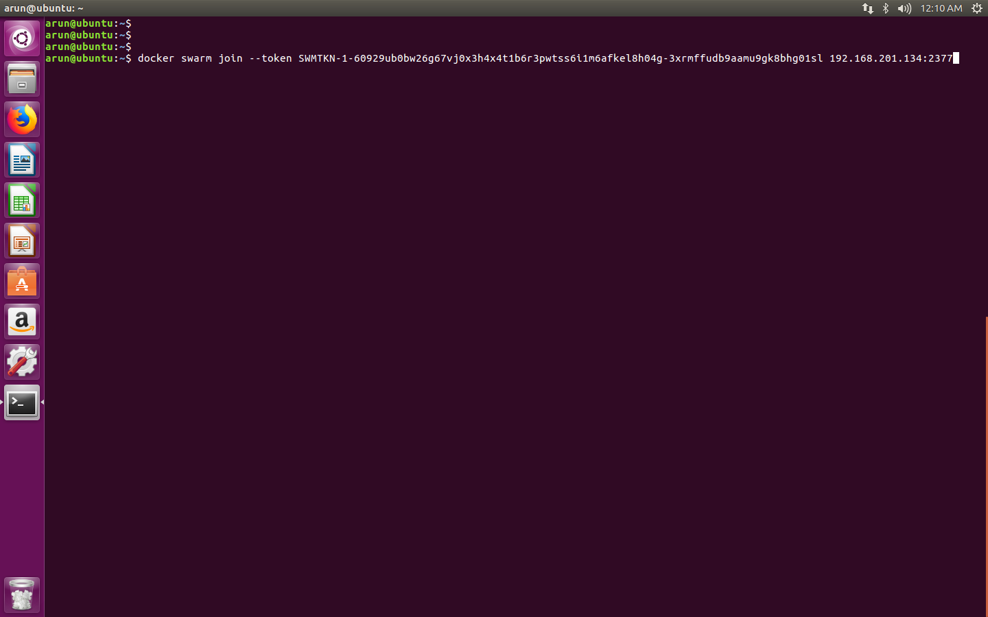

Slide 10
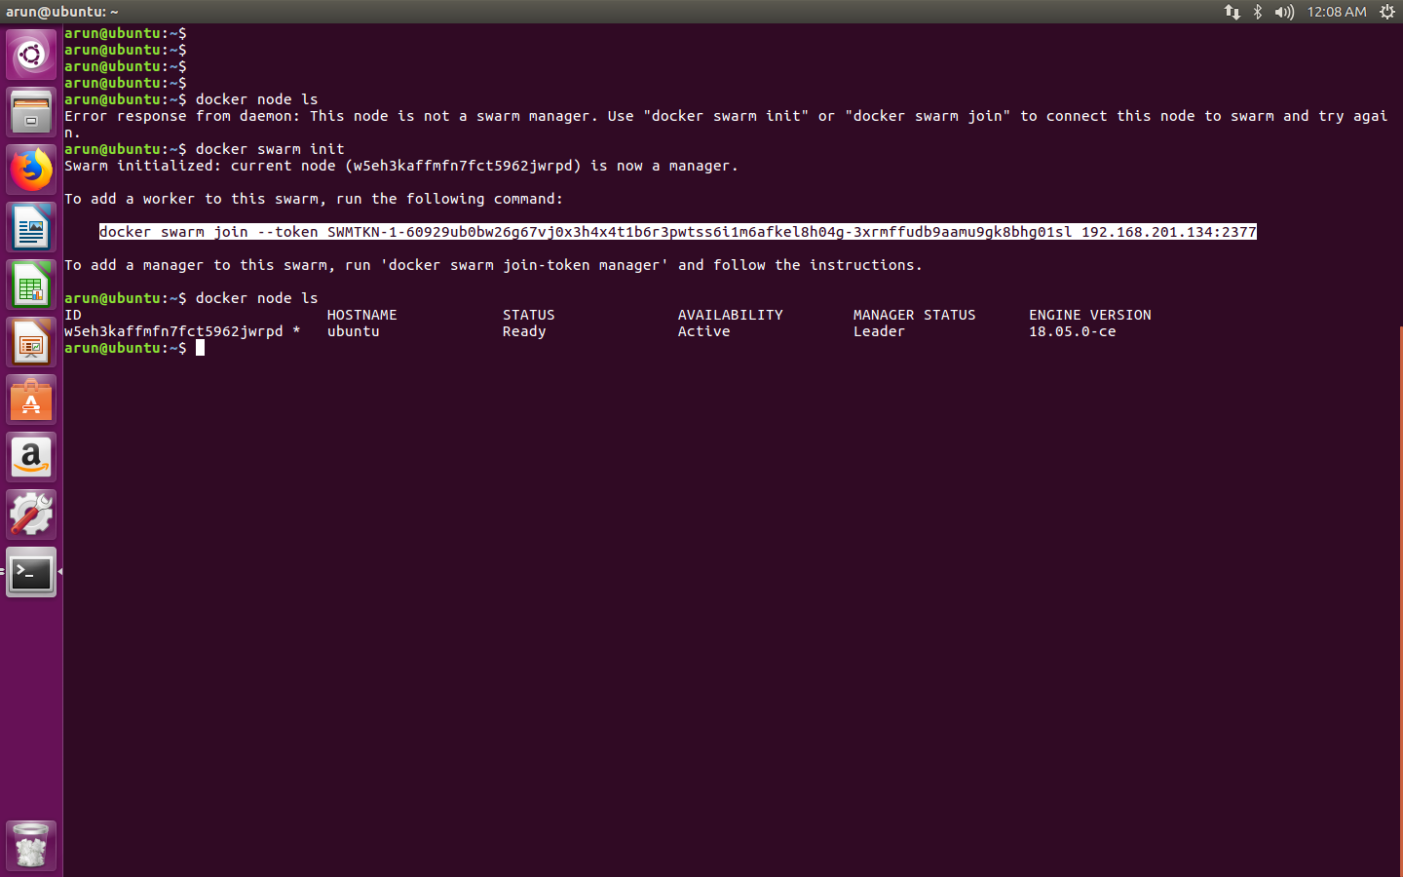

Slide 11
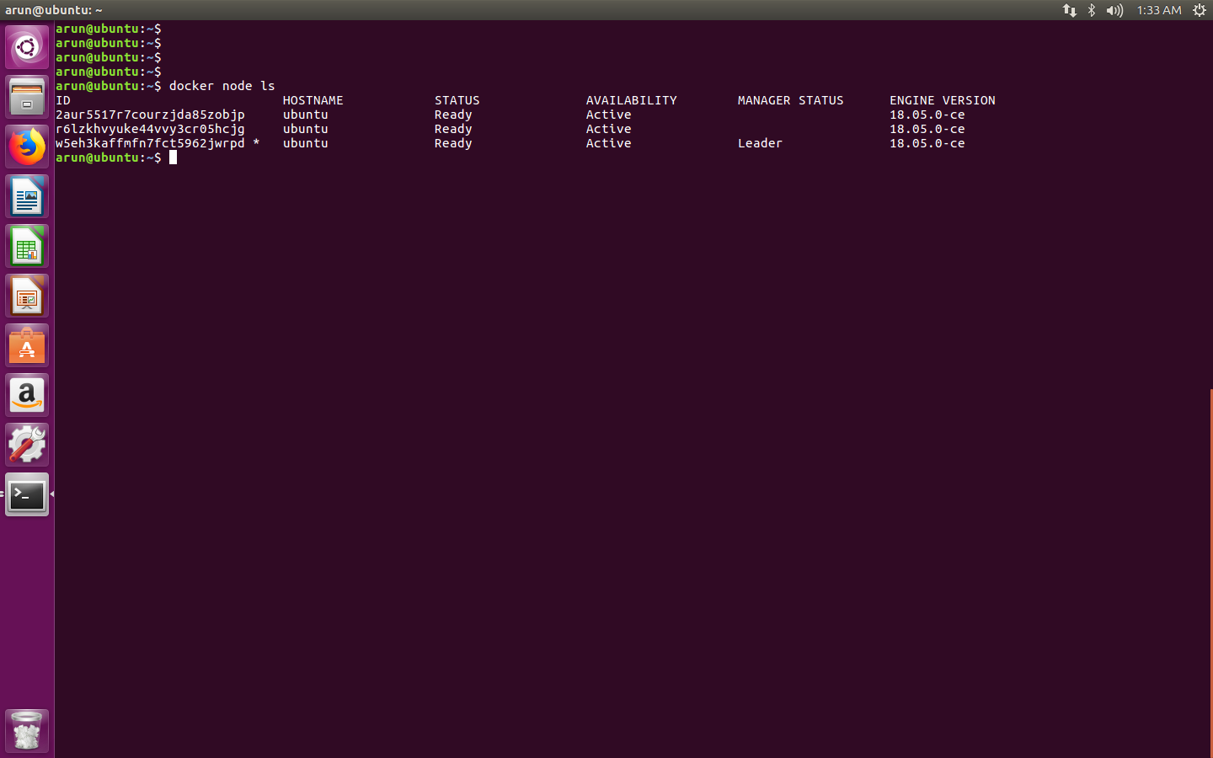

Slide 12
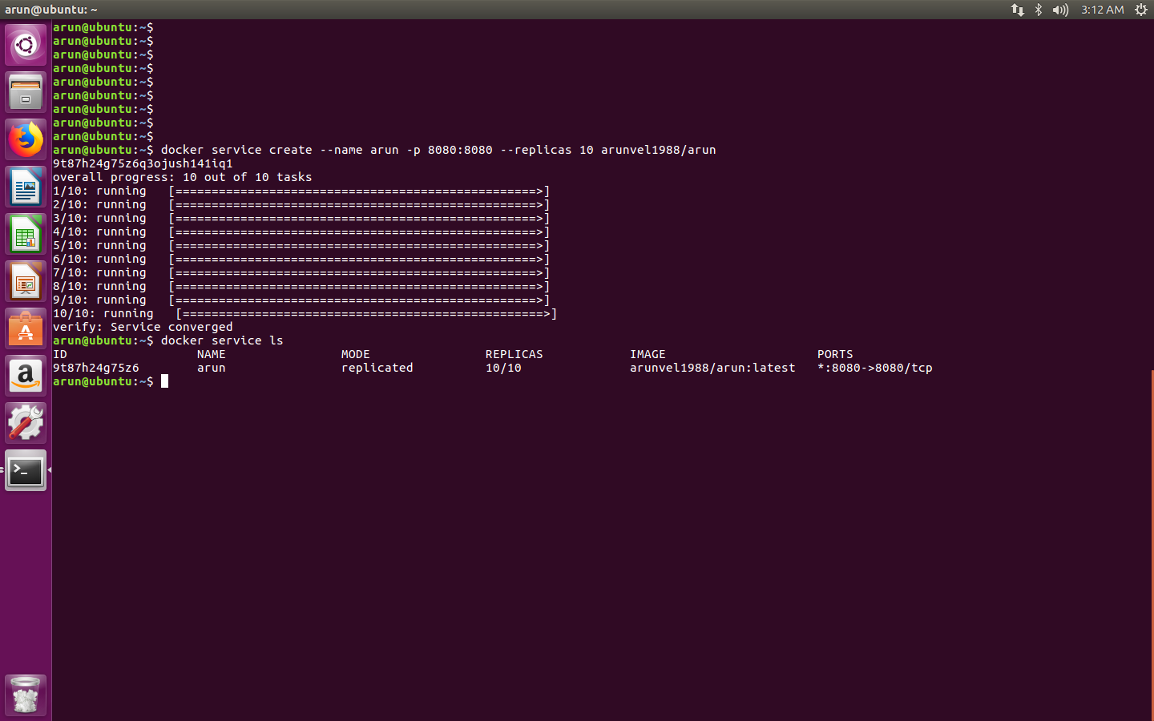

Slide 13
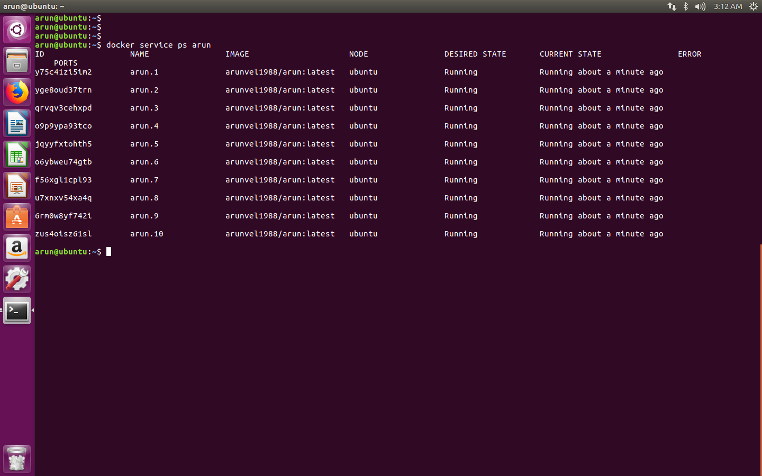

Slide 14
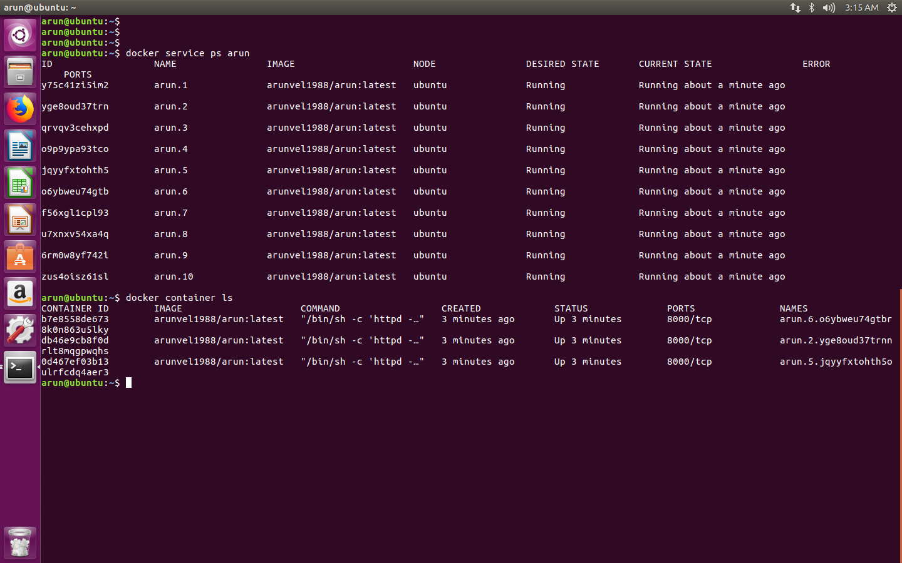

Slide 15
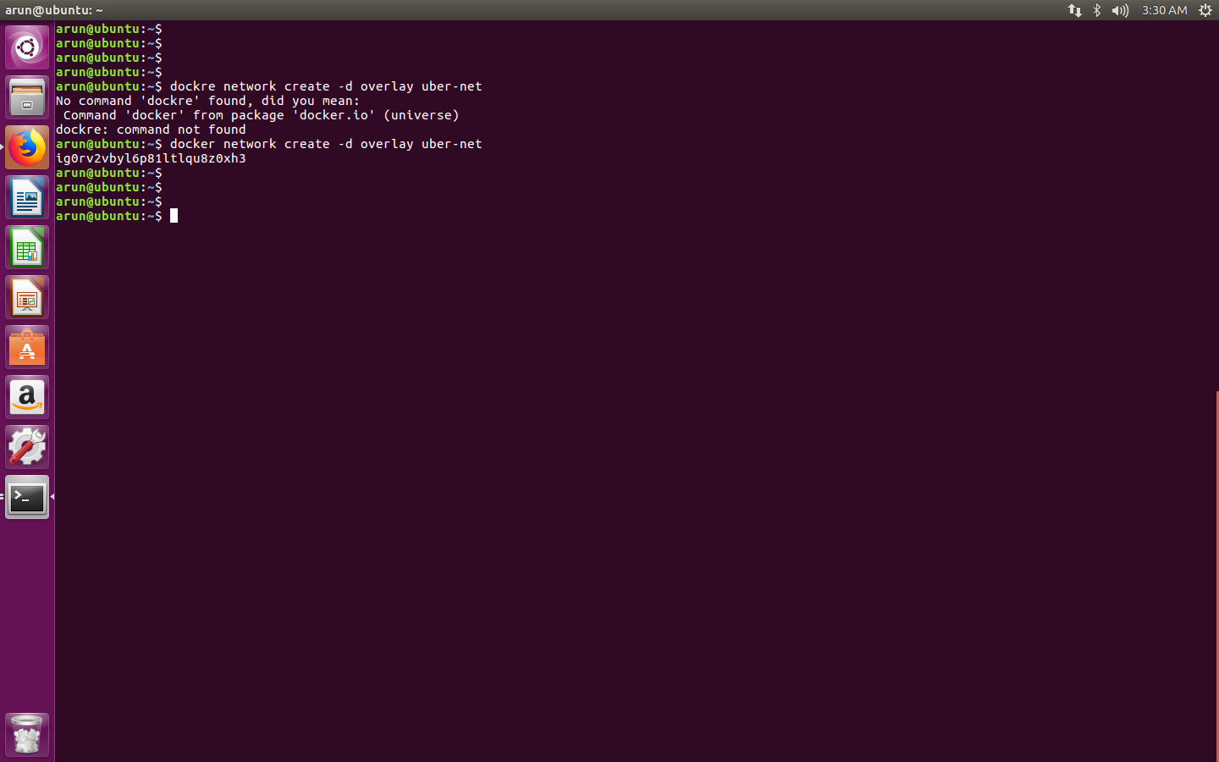

Slide 17
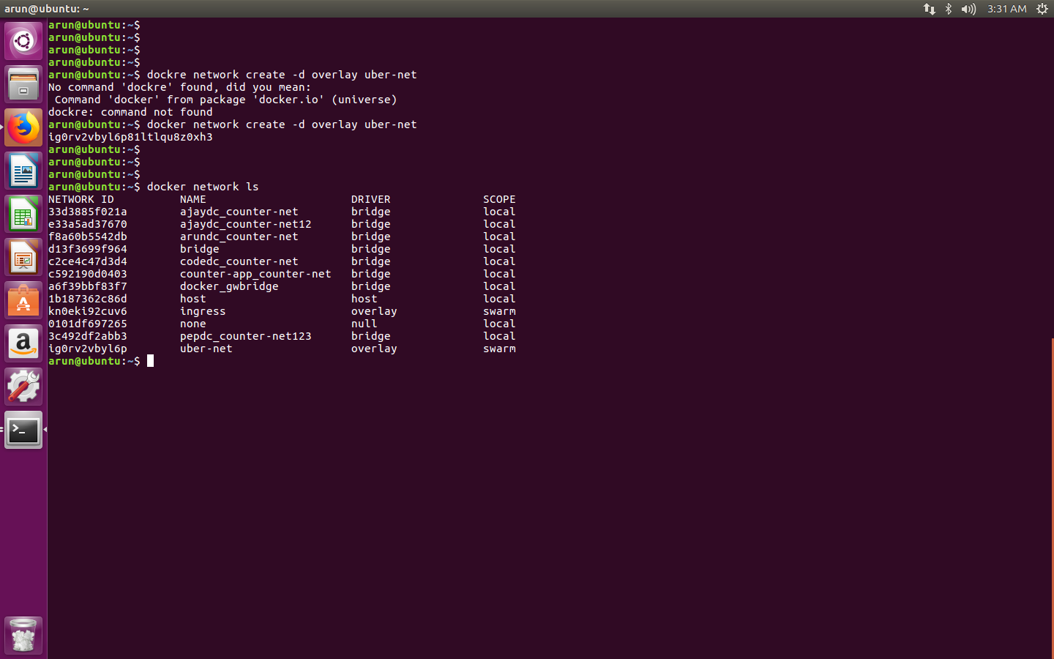

Slide 18
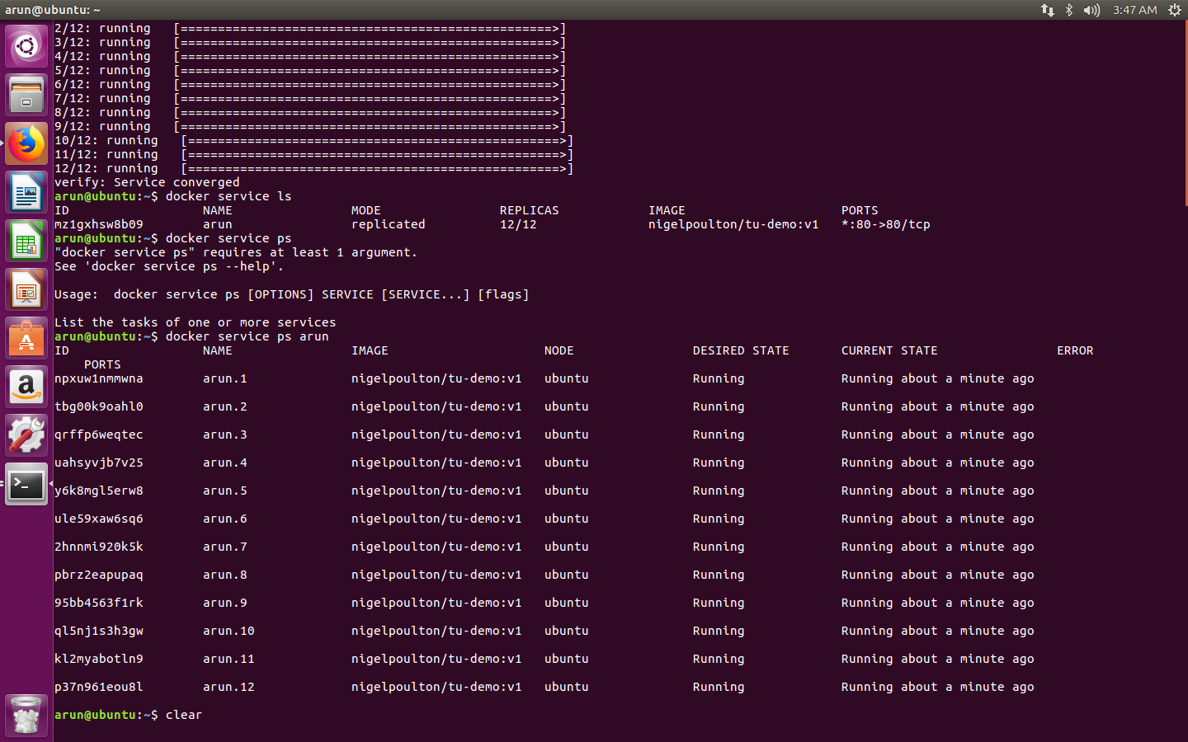

Slide 19
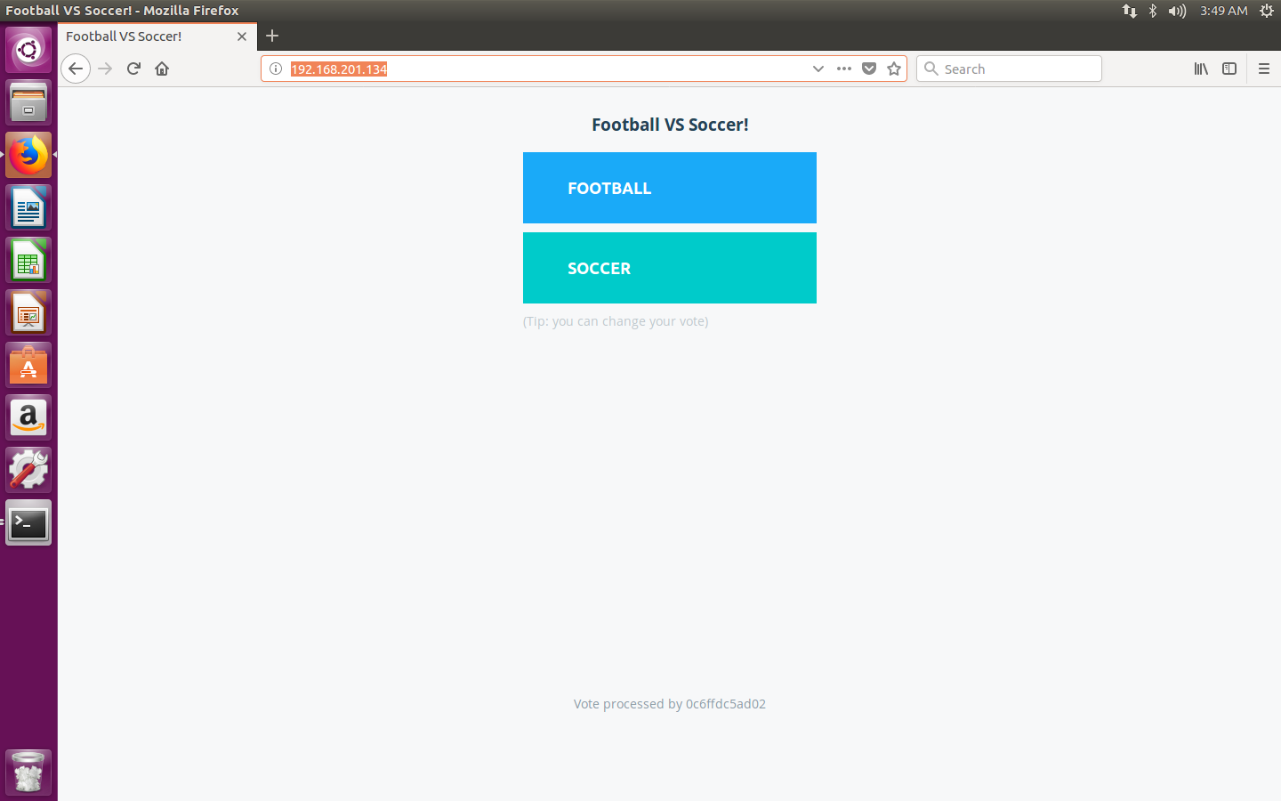

Slide 20
Worker - I
192.168.201.136

Slide 21
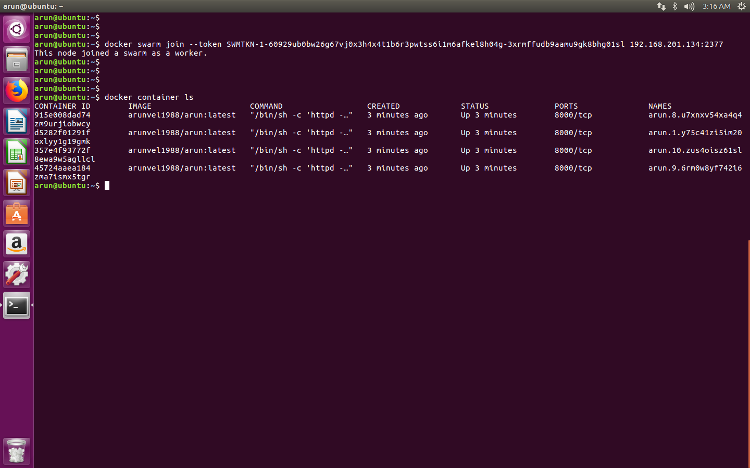

Slide 22
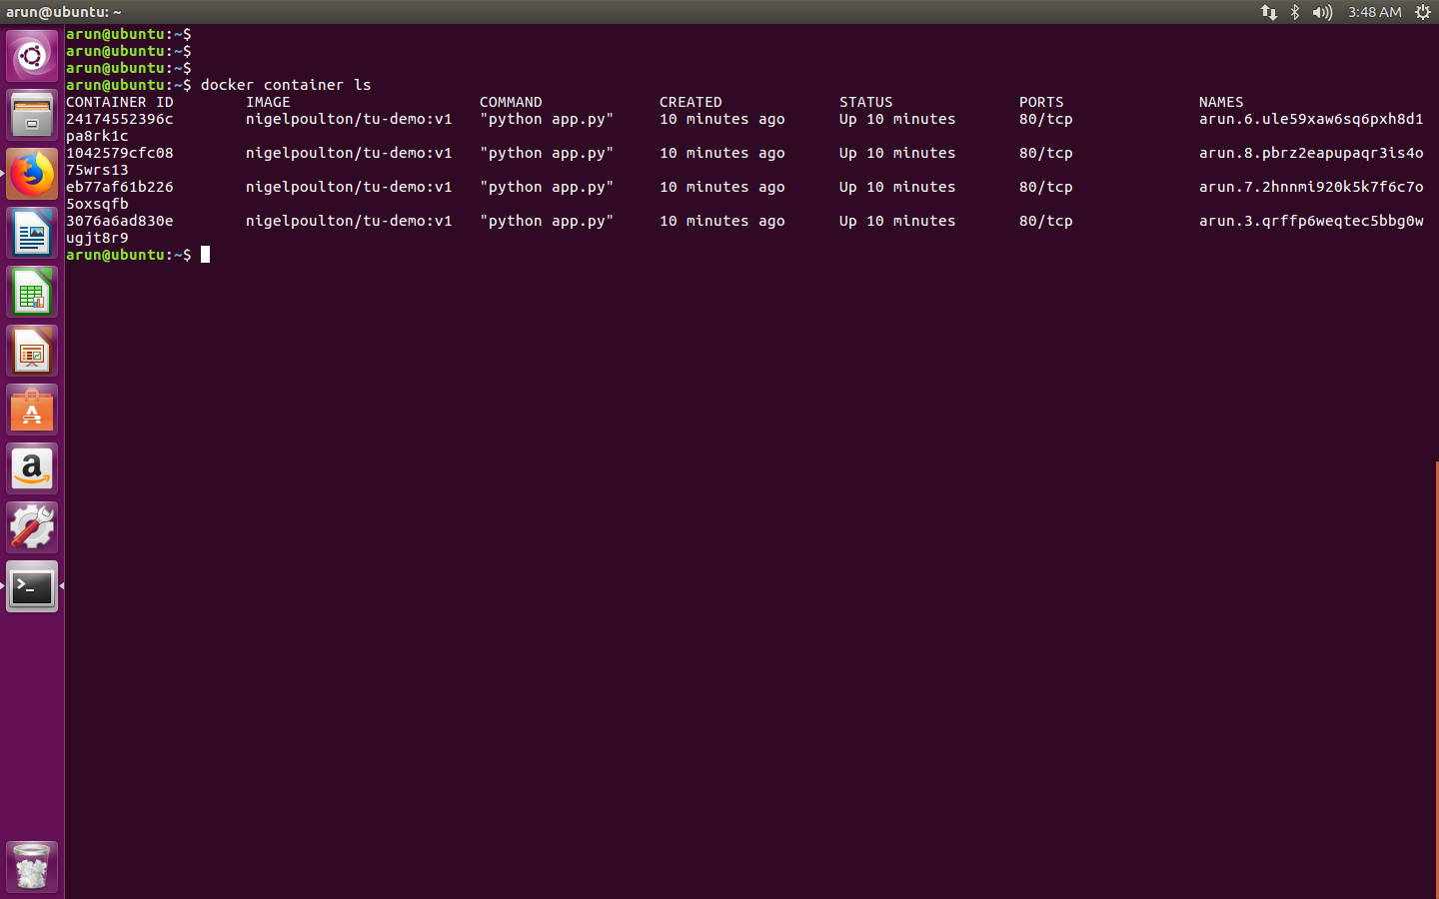

Slide 23
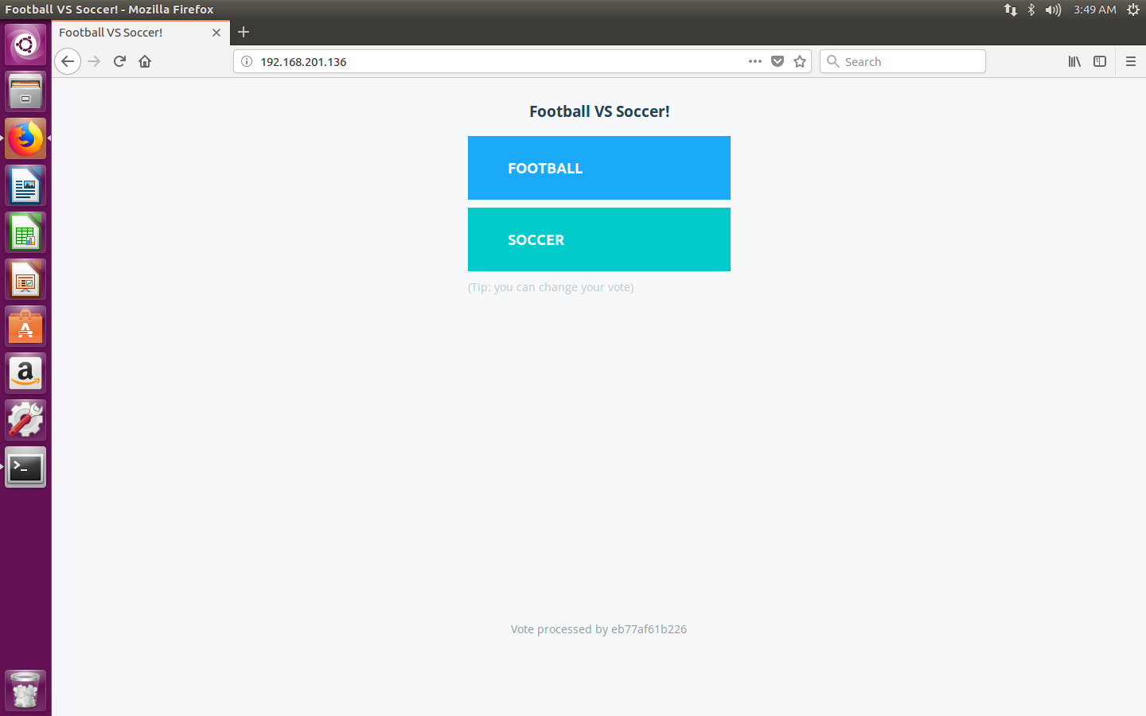

Slide 24
Worker -II
192.168.201.135

Slide 25


Slide 26
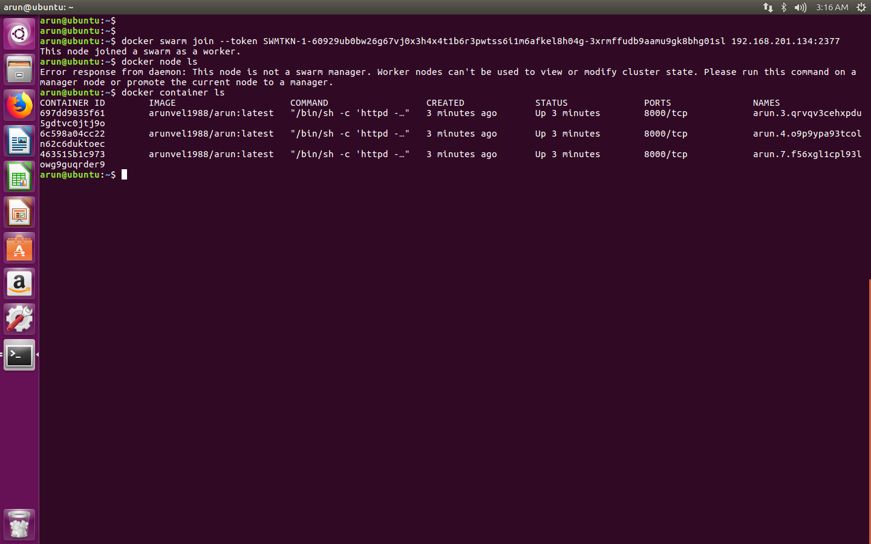

Slide 27
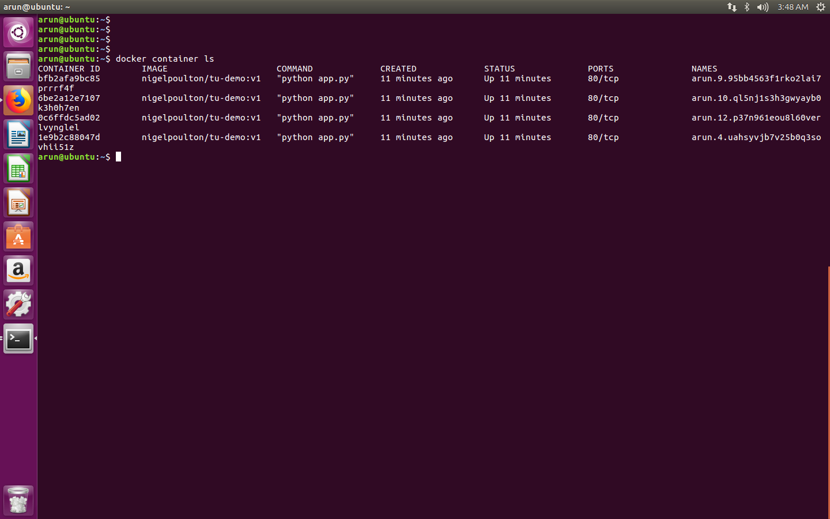

Slide 28


Slide 29
Docker swarm commands
Docker node ls
Docker service ls
Docker service ps arun
Docker service create –name arun
Docker service inspect –pretty arun
Docker service scale arun=20
Docker service rm arun

